Slide 1
Python Project
Group Members-1.Ashutosh Tiwari (leader)
2.Shreyas Chikhalikar
3.Kunal Yadav
Project Name- To Automate Boring stuff using Python

Slide 2
Problem Statement
Reading large excel file, procuring it’s data and sending email to multiple people is a daunting task and consumes large amount of time; time which could otherwise be utilised productively, for the good of the society.
We created a python program to read email address from a excel file and draft an email of predefined structure and send it to them.
So at a single go we can send email to all the students in a class with help of python

Slide 3
Why Use Python
If the selected problem statement wherein we read an excel file, extract data and iteratively send email was to be executed using C language minimum 300 lines of code would have been required.
Python reduces the size of code significantly.
Python has many libraries/packages which can be implemented in our program directly to make it hassle free.

Slide 4
About the Project
In this project we are going to perform following tasks-
Create an excel sheet and it will be located in E:\.
One coloumn will have email id of all the people we want to send the email to.
The other columns will contain other details of the students The python program will read the email id from the sheet and create a html structure using other datas of that row and send it to that specific email.
A conformation message will be displayed on the sender’s scren.
The process will be repeated untill email column is empty.

Slide 5
The use of smtplib
The smtplib stands for Simple Mail Transfer Protocol.
The smtplib module defines an SMTP client session odject that can be used to send mail to any Internet machine with an SMTP or ESMTP listener daemon.
SMTP mail is done with is done with Python’s smtplib using an SMTP server.
"""The first step is to create an SMTP object, each object is used for connection
with one server."""

Slide 6
Code segment for Email
import smtplib
from email.mime.multipart import MIMEMultipart
from email.mime.text import MIMEText
from openpyxl import load_workbook
gmail_user = ""
gmail_pword = ""
msg = MIMEMultipart('alternative')
sent_from = ['shreyaschikhalikar@gamil.com']
msg['Subject'] = 'Attendance Status'
#excel-file=data
def excel_details():
excelfile = 'E:\emaillist.xlsx'
wb = load_workbook(excelfile)
ws = wb[wb.sheetnames[0]]
excel_list=[]
for row in ws.iter_rows(row_offset=1):
for cell in row:
# print(cell.value)
excel_list.append(str(cell.value))
return excel_list
# details is Constructor. Builds template rows for html
class details:

Slide 7
Code
<td style="text-align: right; padding: 10px;">"""+ self.attendance_per[i] +"""</td>
<td style="padding-left: 20px;">"""+ self.status[i] +"""</td>
</tr>
"""
self.template_array.append(template)
self.total = str(self.total)
def send_email(to, msg, new_template):
data.reverse()
for i in range(0, 6):
data.pop()
try:
data.reverse()
server = smtplib.SMTP_SSL('smtp.gmail.com', 465)
server.login(gmail_user, gmail_pword)
server.sendmail(sent_from, to, msg.as_string())
print("Email Sent To: ", new_template.name)
print("@: ", to)
print("Roll No : ", new_template.roll_no)
print("Attendance: ", new_template.total, "\n---------------------------")
server.quit()
if(data[0] == 'None'):
print('END OF LIST')
else:
build_email(data)
except Exception as e:
print(e)
print('Email Failed to Send to: ', new_template.name)
print("@: ", to)
print("Roll No : ", new_template.roll_no)
def __init__(self, name, roll_no, date, attendance_per, status):
self.name = name
self.roll_no = roll_no.split(",")
self.date = date.split(",")
self.attendance_per = attendance_per.split(",")
self.status = status.split(",")
self.total = 0
self.template_array = []
# print(self.status[0], self.roll_no, self.to)
# sum attendance_pers for total
for i in range(0, len(self.roll_no)):
self.total += int(self.attendance_per[i])
template = """
<tr class="left">
<td style="padding: 10px; text-align: left;">"""+ self.roll_no[i] +"""</td>
<td style="padding: 10px;">""" + self.date[i] + """</td>

Slide 8
Code
data = excel_details()
#print(data)
def build_email(data):
# print(data[5])
new_template = details(data[0], data[1], data[2], data[3], data[4])
to = data[5].split(",") #This must be a list i.e. ['someaddress@gmail.com']
text = "Hello, {0}, roll no - {1} \n As on the dates {2} , your attendance is {3}. You are encouraged to maintain minimum attendance of 75%.\n Thank You.\n TCY College.".format(data[0], data[1], data[2], data[3])
#use IN-LINE Styling
html = """\
<!DOCTYPE html>
<html>
<body>
<p style="text-align: center"> Hello, """+ new_template.name +""" Hope this email finds you well.</p>
<p style="text-align: center">Here are your details.</p>
<hr style="width: 500px;">
<table style="margin-left: auto; margin-right: auto">
<tr>
<th>Attendance:</th>
<th style="padding-left: 100px">"""+ new_template.total +"""%</th>
</tr>
</table>
<hr class="width">
<table style="margin-left: auto; margin-right: auto">
<tr class="left padded">
<th style="text-align: left;"> Roll No </th>
<th> Date </th>
<th style="text-align: right;"> Attendance </th>
<th style="padding-left: 20px;"> Status </th>
</tr>
""" + ''.join(new_template.template_array) + """
</table>
<hr style="width: 500px;">
<table style="margin-left: auto; margin-right: auto; padding: 10px;">
<tr>
<th> Thank You! </th>
</tr>
<tr>
<th> Chikhalikar Institute of Law,Medical & Engineering. </th>
</tr>
</table>
<hr style="width: 500px;">
</body>
</html>
"""
part1 = MIMEText(text, 'plain')
part2 = MIMEText(html, 'html')
msg.attach(part1)
msg.attach(part2)
send_email(to, msg, new_template)

Slide 9
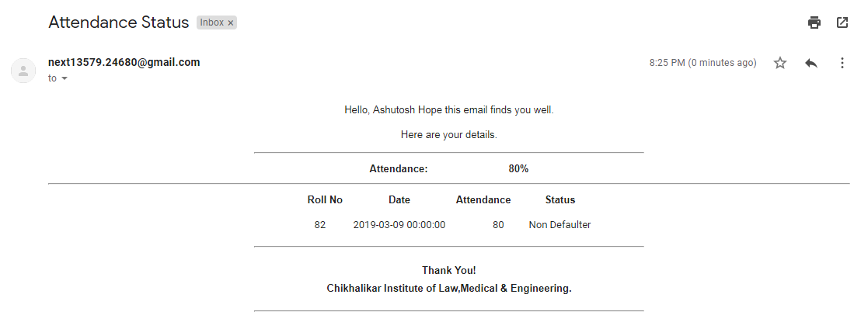
Receiver’s View

Slide 10
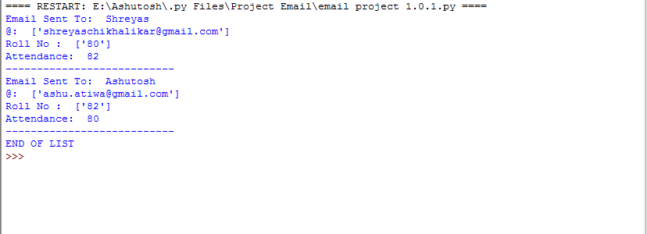
Sender’s View

